Slide 1
Introduction to Matlab
Week 7
Day 26

Slide 2
Overview of Matlab
MATLAB stands for “MATrix LABoratory”
Published by The Mathworks (www.mathworks.com)
Vectorization
Matlab works with array (i.e., vector & matrix) variables as easily as scalar (single-value) variables
Powerful matrix math functionailty
Built in capabilites
Arithmetic functions, add-on toolboxes, advanced visualization/plotting, and much more
Script files
Method for writing user programs
Can connect with traditional programming languages

Slide 3
Matlab vs. VBA vs. “Traditional” Programming languages
Each has its own strengths for particular applications
VBA
Basic graphing, numerical methods, making spreadsheets interactive
Commonly found, used in industry
Low cost
Matlab
More powerful analytical tool
Many available add-on toolboxes, etc.
C/C++, Fortran, other programming languages
Intensive computations
High calculation speed
Specialized compilers, sometimes platform specific

Slide 4
Programming…
Specific syntax, languages, etc. different
What we learned while using VBA will almost all apply to Matlab!
General programming structures the same
Decisions (If-Then-Else,)
Loops
Functions
Arrays (Vectors/Matrices)

Slide 5
Will I use MATLAB in other classes??
Numerical Methods
Currently taught exclusively in Matlab
Control Systems/ System Dynamics
Matlab & Simulink (physcial simulation add-on toolbox)
Other classes
Matlab is available on all lab PCs in the Mech.E. department – you can use it for any intensive numerical calculations you might do

Slide 6
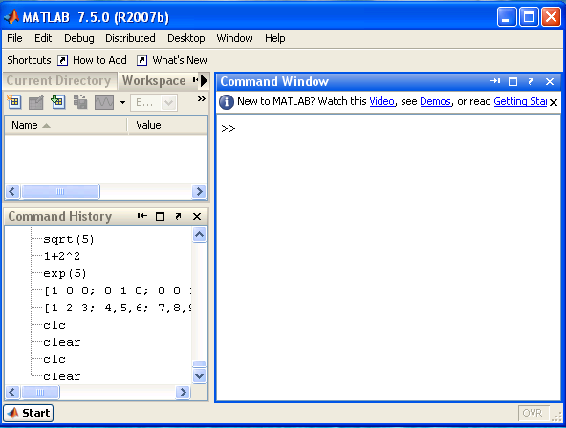
Matlab Environment
Work- space
Current directory window
Command history window
Command window

Slide 7
Matlab Environment
Upper left – Current directory or workspace
Workspace – all variables, size of variables
Bottom left
Command history
Useful for cutting and pasting commands
Right
Command Window
Where you perform basic calculations
( The layout may be different for different versions)

Slide 8
Matlab Command Window
Try using it as a calculator
5*5
cos(pi) (pi is a reserved, predefined value!)
cosd(30) (cosd takes argument in degrees!)
5/2
sqrt(5)
1+2^2
Up arrow
Up arrow allows you to move through list of commands you have executed

Slide 9
Matlab Command Window
To clear out the command window:
clc
Comments
VBA used apostrophe ’
Matlab uses percent symbol %
Case-sensitivity
Variable names are case-sensitive
All Matlab commands are lower-case

Slide 10
Workspace Window
Keeps track of variables you have created
Notice “default” variable ans used for calculations where result is not assigned to a variable
Type A = 5 to create variable A
How about B = [1, 2, 3, 4]
B is single dimension array (or a vector)
Can create multi-dimensional array
Type C=[1 2 3 4; 10 20 30 40; 5 10 15 20]
Look at dimensions: 3 x 4
Double click on variable in Workspace window
Can change values in array editor
Now look at C in command window
To clear Workspace (and all variables in it)
clear

Slide 11
Semi-colon Notation
What happens if you type
A=[1 2 3 4 5] vs. A=[1 2 3 4 5];
Semi-colon useful when performing complicated calculations with large matrices and in scripts (programs)

Slide 12
Variable Types
To create a variable, simply assign a value to a name
a=25
stringname=‘hello world’
No variable declaration – all Matlab variables are like VBA “Variant”
Names must start with a letter
Only allowable characters are letters, numbers, and underscore; no spaces allowed (similar to VBA)
Like Excel or VBA, has reserved list of keywords
Check if name is reserved using “which” command
e.g. “which A”
Returns “A is a variable”
vs. “C:\PATHNAME\name.m”

Slide 13
Basic Arithmetic Operators
Arithmetic operations (+ ,- ,*, /)
100/7
(1+i)*(2+i)
Exponentiation (^)
10^2
(1*i+2*j)^2
Complicated expressions, use parentheses
((2+3)*3)^0.1
Matlab uses algebraic order of operations, including parenthesis:
^, * or /, + or –
So 0.5*1*2^2+1= 3 ; (0.5*1*2)^2+1=2
-1^2 = -1, (-1)^2 = 1 – like VBA!
Matlab has more complex precedence rules involving matrices and complex numbers as well

Slide 14
Built in functions
MATLAB has a huge library of built-in functions
sqrt(2)
log(2), log10(0.23)
cos(1.2), atan(-.8)
sind (30)
exp(2+4*i)
round(1.4), floor(3.3), ceil(4.23)
abs(-10)
To see a list of built in “elementary functions” available, enter
help elfun

Slide 15
Script Files
Can save values you create, but not command history
If you want to save your commands or repeat commands
Need to save commands into an “m-file”
An m-file (or “script”) is similar to creating a VBA program
IMPORTANT: Name of an “m-file” cannot have any spaces!
To run a script file, the file must appear in the “Current Folder” window in Matlab. Click “Save & Run” in Editor.
Can break script file into “cells”
Treated similarly to different Sub procedures in a VBA module
Use double percent symbol: %%

Slide 16
Simple Input and Output
INPUT
a=input(‘enter value of A’);
OUTPUT
disp(a)
Construct a string variable to make disp more useful
message=['the value of pi is ' num2str(pi)];
disp(message)
Formatted printing
fprintf(‘print the value of a is % i \n’, a)
Format codes:
% i ( for integers)
%e (for exponential)
%f (for floating point format)

Slide 17
In-class Exercises
Do the following in-class problems in the same m-file, but use different cells

Slide 18
Solving simple problems with Matlab In-Class Exercise #1
Solve this problem using a script file:
Calculate
Where
a = 15.62,
b = -7.08,
c = 62.5,
d = 0.5 (a b - c)
Use built-in functions: abs(), sqrt()

Slide 19
Solving simple problems with Matlab In-Class Exercise #2
Solve this problem using a script file:
Calculate
Where
x = 9.6,
z = 8.1
Use built-in function: exp()

